Slide 1
GAN Application
Random Number Generator
https://youtu.be/3N_otcqpFlM

Slide 2
GANs
Generative Adversarial Networks
Two Models
Generator
Discriminator

Slide 3
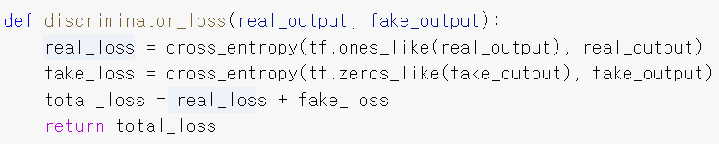
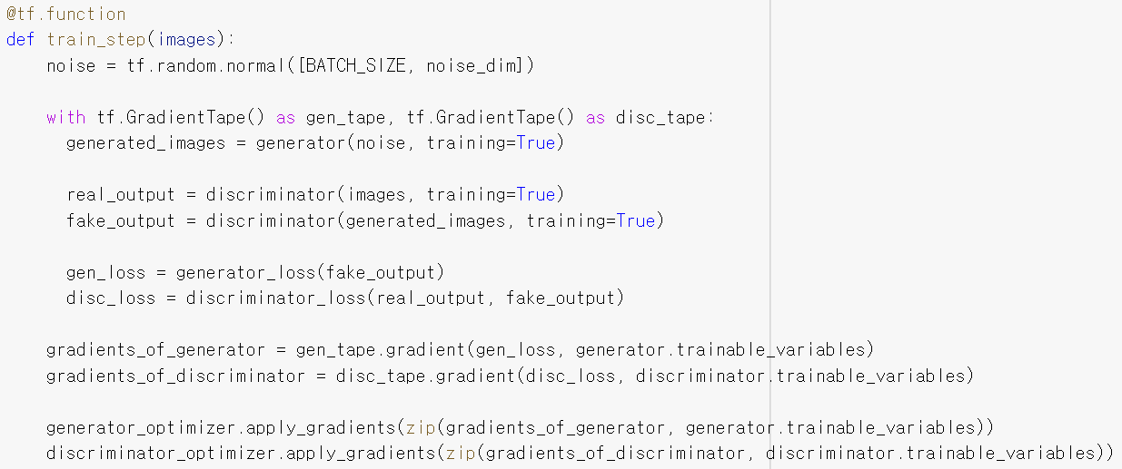

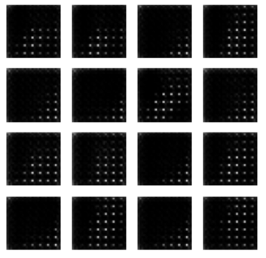
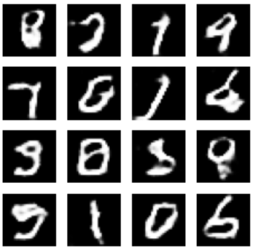
GANs Example Code
https://www.tensorflow.org/tutorials/generative/dcgan?
Using MNIST Data

Slide 4
RNG
Random Number Generator
Two RNGs
TRNG(True RNG)
PRNG(Pseudo RNG)
Seed s

Slide 5



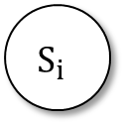
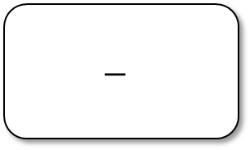
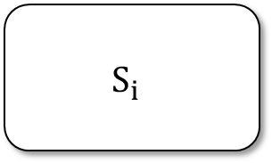
Design
s
$$S_{i}$$
$$−$$
s
output
output
$$S_{i}$$

Slide 6
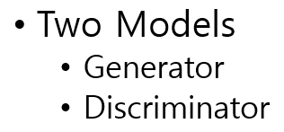


Design
Training Data
s
Generator
Discriminator
$$S_{i}$$
s
Generator
Predictor
$$S_{i}$$

Slide 7





Design G
s
FCFF
Leaky RELU
FCFF
Leaky RELU
FCFF
Leaky RELU
FCFF
Leaky RELU
FCFF
Mod
$$o_{i}$$
Loss = absolute difference loss
Optimizer = Adam
https://medium.com/@himanshuxd/activation-functions-sigmoid-relu-leaky-relu-and-softmax-basics-for-neural-networks-and-deep-8d9c70eed91e

Slide 8



Design D or P
s
Conv1D
Leaky RELU
Conv1D
Leaky RELU
Conv1D
Leaky RELU
Conv1D
Leaky RELU
MaxPool
$$o_{i}$$
FCFF
Leaky RELU
FCFF
Leaky RELU
Loss = absolute difference loss
Optimizer = Adam

Slide 9
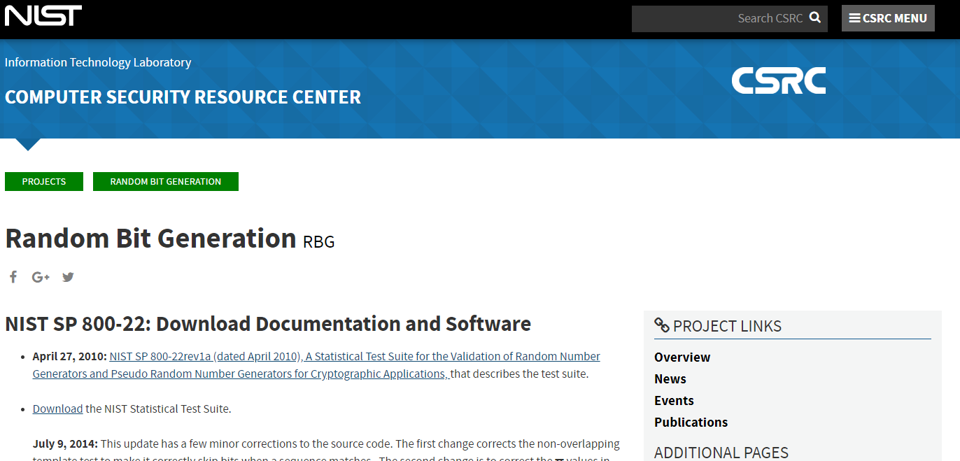
Experimental Procedure
Generate data with untrained Generator → Data 1
Generate data with trained Generator → Data 2
Compare Data 1 and Data 2 using NIST test suite
NIST test suite
188 tests,
Each repeated 10 times
1,000,000 input bits for each repetition
https://csrc.nist.gov/projects/random-bit-generation/documentation-and-software

Slide 10
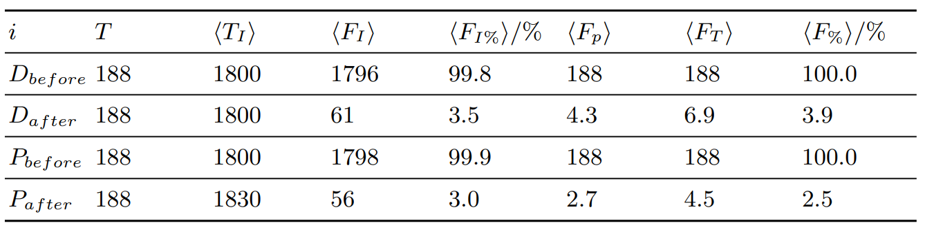
Evaluation
Best pass rate was around 98%.
Non-cryptographic PRNGs.

